Slide 1
Case Study 1 ŽENA IZ PERSPEKTIVE PLASTIČNOG HIRURGA Prof. dr Mehmet Mutaf, spacijalista rekonstruktivne hirurgije Klinika Acibadem

Slide 2
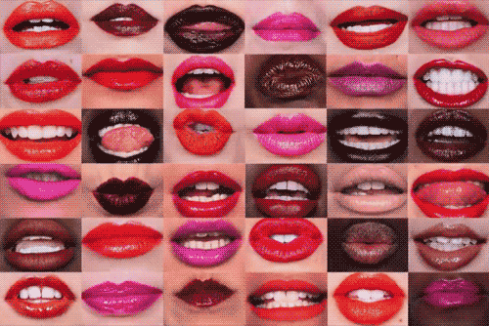
LISTEN WHAT THEY SAY

Slide 3
HOW CAN I HAVE A BETTER LIFE ?
The Most Common Anomaly of the FACE
Universty of Gaziantep, Plastic Reconstructive and Aesthetic Surgery Department
TURKEY 2007

Slide 4
HOW CAN I FIND A GOOD JOB ?
The Most Common Anomaly of the FACE
Universty of Gaziantep, Plastic Reconstructive and Aesthetic Surgery Department
TURKEY 2007

Slide 5
HOW CAN I FIND A WEALTHY, HEALTY AND GOOD LOOKING HUSBAND ?
The Most Common Anomaly of the FACE
Universty of Gaziantep, Plastic Reconstructive and Aesthetic Surgery Department
TURKEY 2007

Slide 6
HOW CAN I MAKE MY GIRL FRIENDS DYING OF JEALOUSY ?
Universty of Gaziantep, Plastic Reconstructive and Aesthetic Surgery Department
TURKEY 2007

Slide 7
HOW CAN I STAY YOUNG ?
Universty of Gaziantep, Plastic Reconstructive and Aesthetic Surgery Department
TURKEY 2007

Slide 8
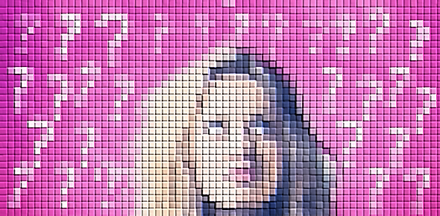
HOW CAN I HAVE A BETTER LOOK ?
Universty of Gaziantep, Plastic Reconstructive and Aesthetic Surgery Department
TURKEY 2007

Slide 9
HOW CAN I GET REVENGE ON MY EX BOYFRIEND ?
Universty of Gaziantep, Plastic Reconstructive and Aesthetic Surgery Department
TURKEY 2007

Slide 10
HOW CAN I FEEL MYSELF BETTER ?
Universty of Gaziantep, Plastic Reconstructive and Aesthetic Surgery Department
TURKEY 2007

Slide 11
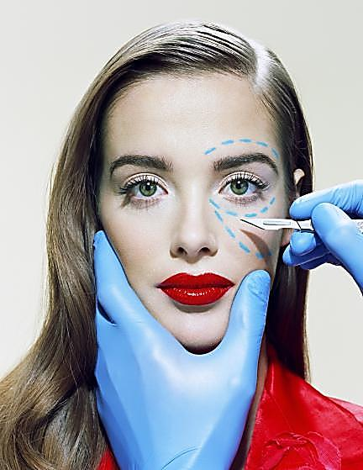

Slide 12
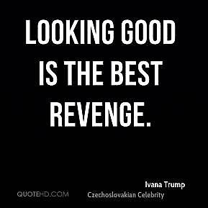

Slide 13
WHY DO WE NEED PLASTIC SURGERY ?

Slide 14
DOCTOR, I AM THINKING OF SUICCIDE ☹

Slide 15
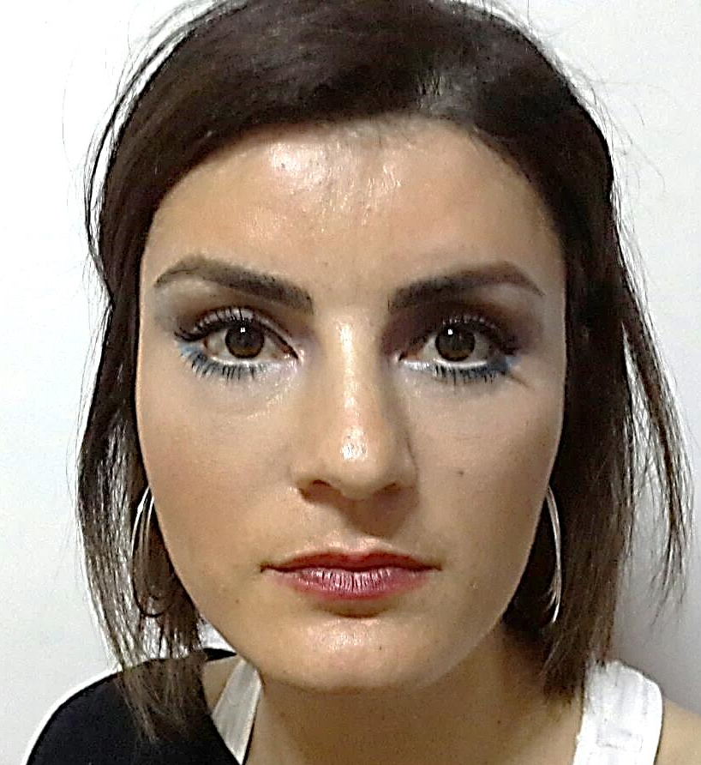
LOOKING GOOD BUT STILL SAD…
Midface Lift + Fat Infiltration + PRP + Brow Lift + Upper Blepharoplasty

Slide 16
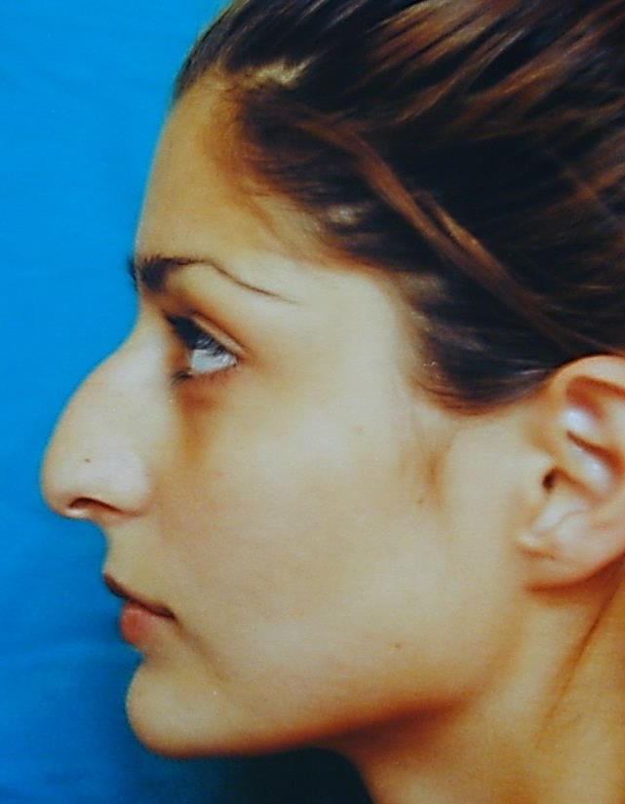
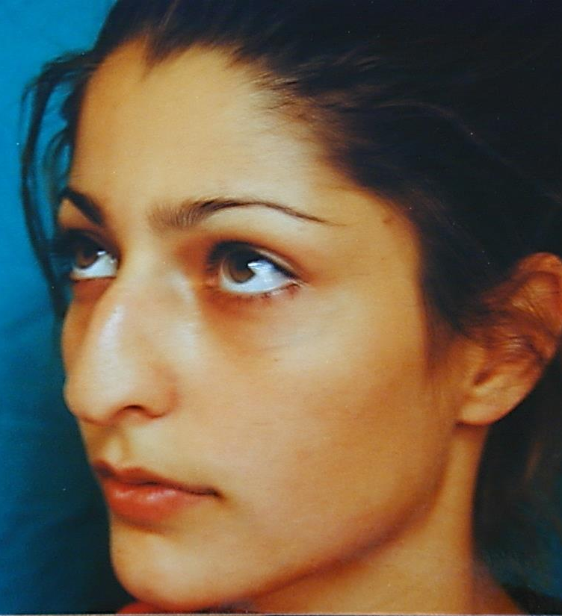
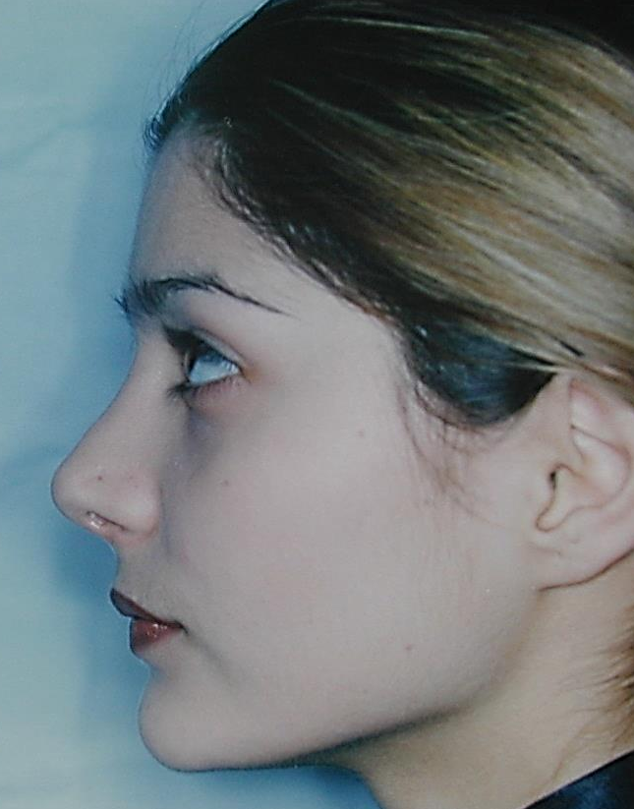
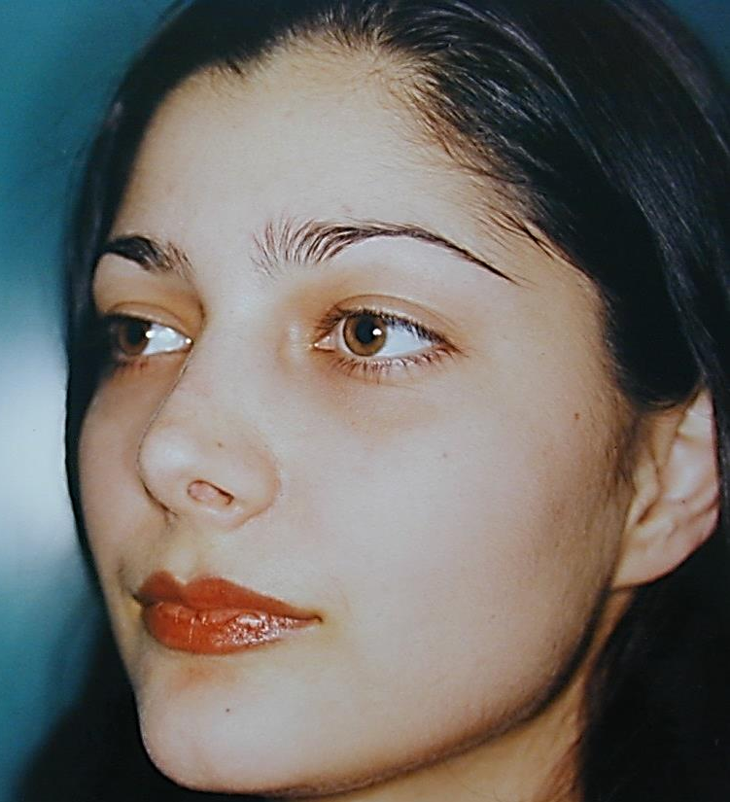
I WANT BREATH NORMALLY ;)

Slide 17
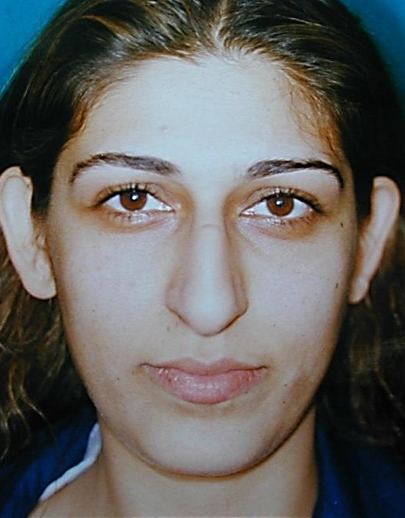
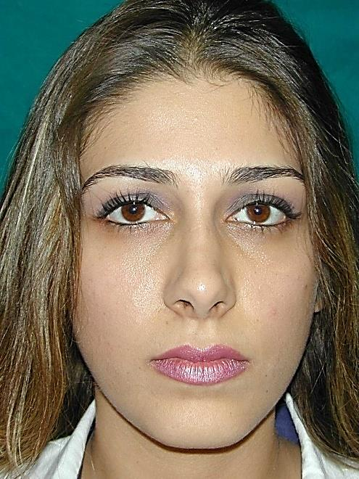
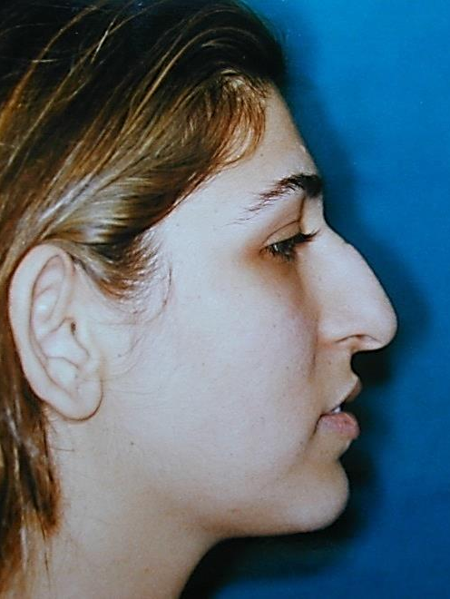
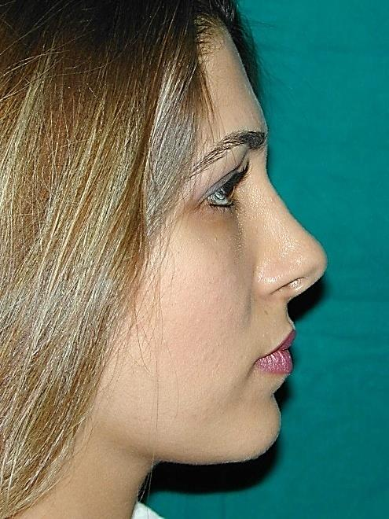
BELIEVE ME DOCTOR… I WANT BREATH NORMALLY TOO ;)

Slide 18
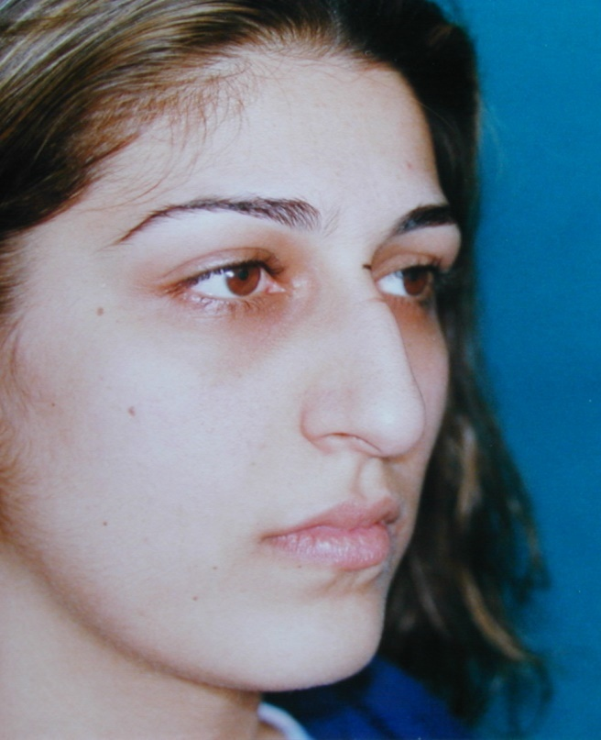
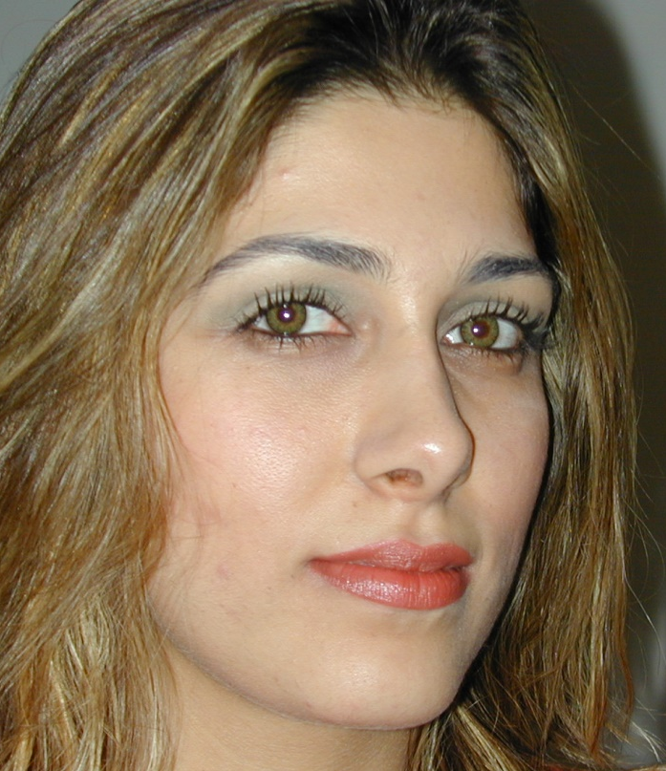
GOOD RESULT WITH A SWEET BONUS … Who could reject a good-looking doctor husband ;)
BEFORE
Not happy at all
At 3 MONTHS, Happy with the Result
At 6 MONTHS ,
Happily Married

Slide 19
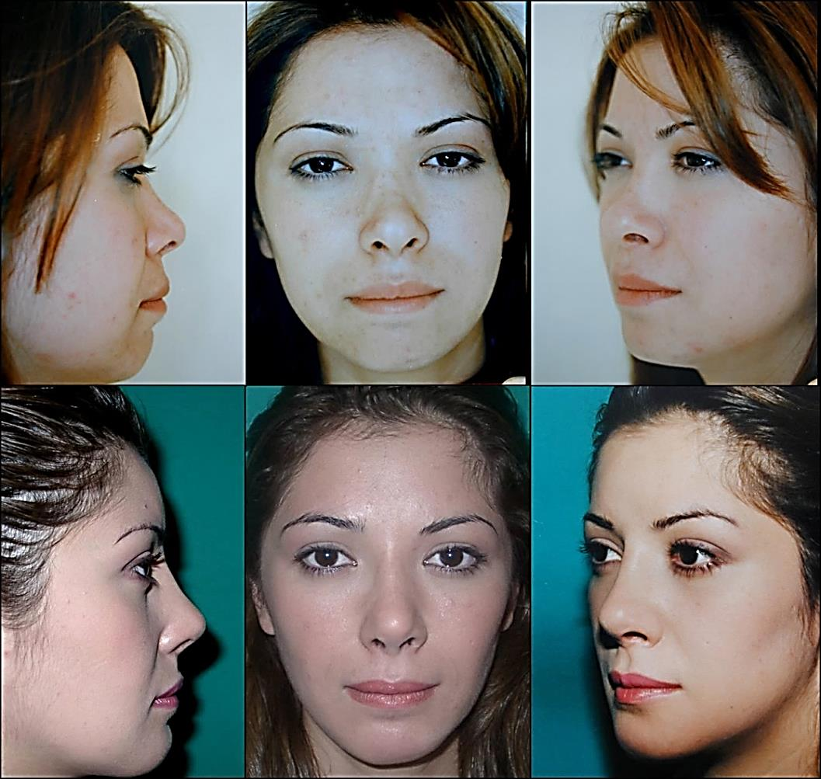
COMBINED FACIAL AESTHETIC PROCEDURES
I WANT MY NOSE REDONE PLUS I WON’T SAY NO FOR A SIMILAR BONUS WITH THAT U GAVE TO HER ! GOT IT ?
Saddle Nose Correction + Buccal Fat Removal + LİPO Infitration + Chin Augmentation

Slide 20
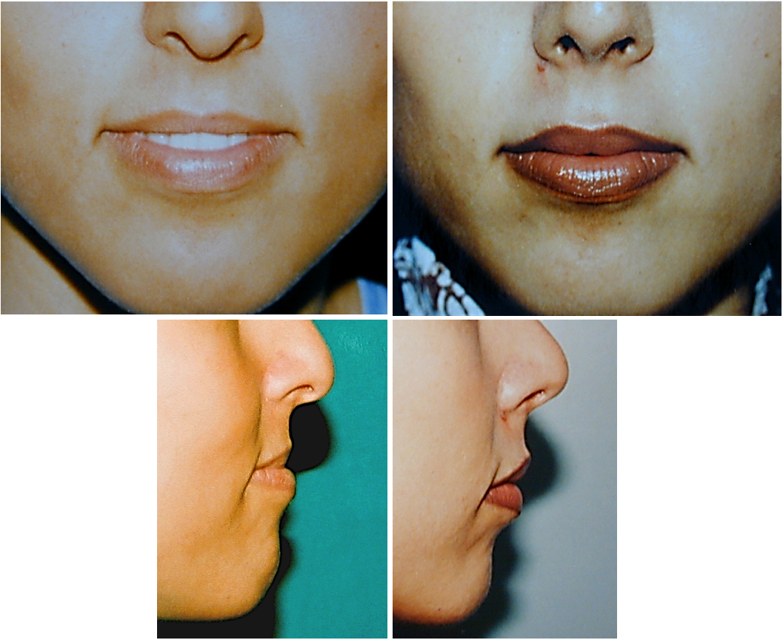
ORTHOGNATHIC SURGERY
I WANT MY JAWS TO HAVE A BETTER RELATIONSHIP WITH EACH OTHER

Slide 21
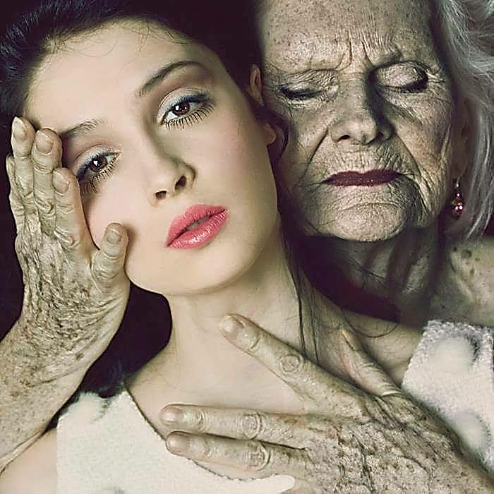
I WANT MY YOUTH BACK !

Slide 22
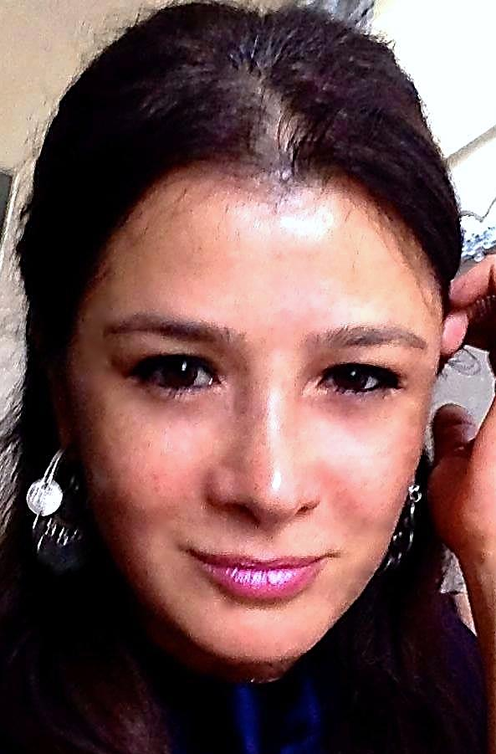
I DON’T WANT TO LOOK SO TIRED
COMBINED FACIAL PROCEDURES
Face lift + Saddle Nose Correction + Buccal Fat Removal + Browlift + Lower Blepharoplasty

Slide 23
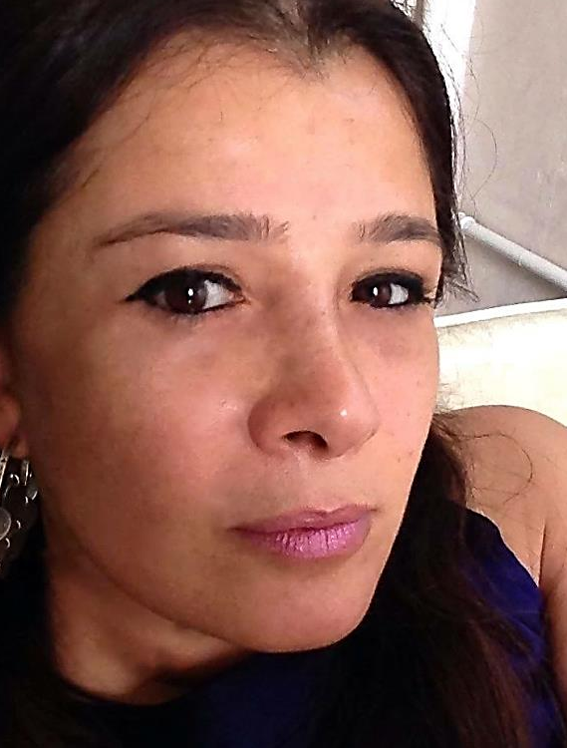
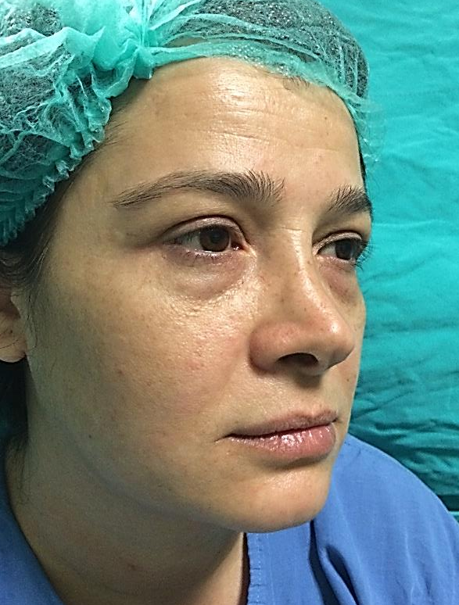
COMBINED FACIAL PROCEDURES
Face lift + Saddle Nose Correction + Buccal Fat Removal + Browlift + Lower Blepharoplasty

Slide 24
I WANT TO LOOK YOUNGER for A SECOND CHANCE IN THE LIFE
COMBINED FACIAL PROCEDURES
Face lift + Upper Lip Lift + Rhinoplasty + Fat Infiltration + Browlift + Upper and Lower Blepharoplasty + Mentoplasty

Slide 25
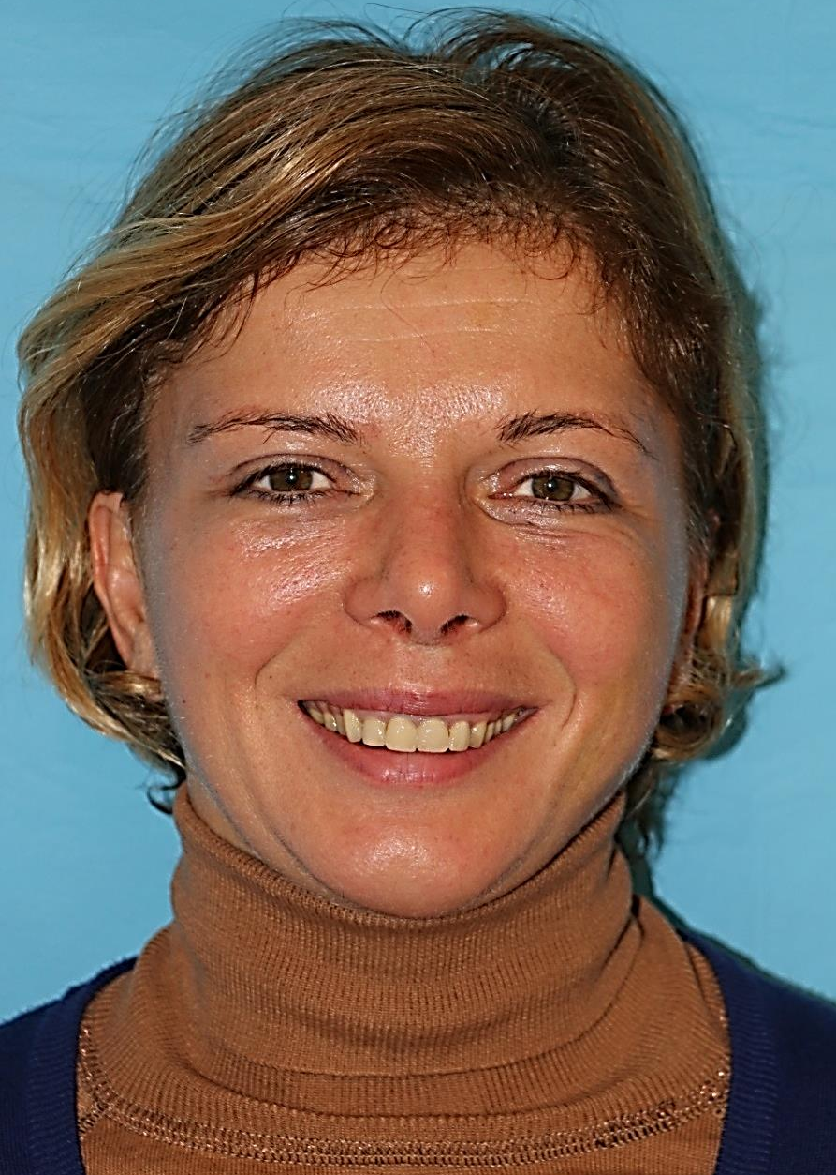
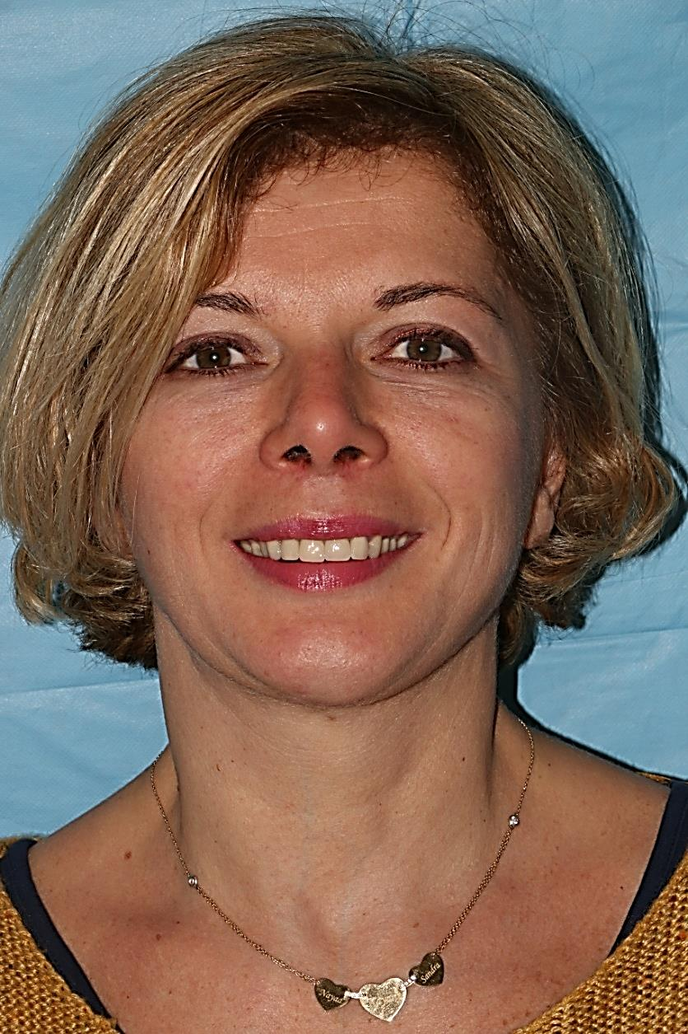
COMBINED FACIAL PROCEDURES
Face lift + Upper Lip Lift + Rhinoplasty + Fat Infiltration + Browlift + Upper and Lower Blepharoplasty + Mentoplasty

Slide 26
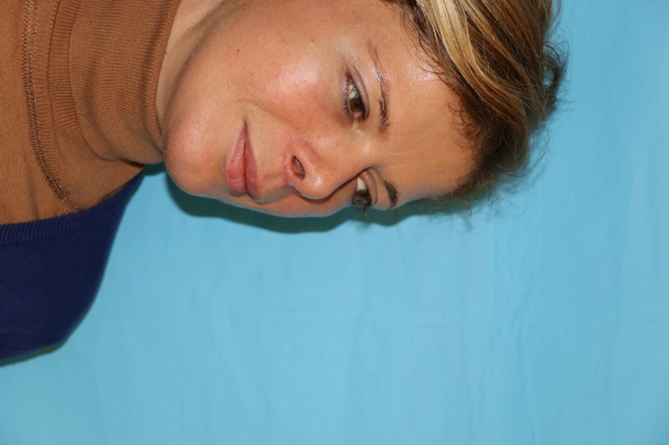
COMBINED FACIAL PROCEDURES
Face lift + Upper Lip Lift + Rhinoplasty + Fat Infiltration + Browlift + Upper and Lower Blepharoplasty + Mentoplasty

Slide 27
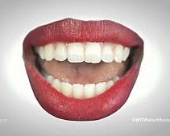
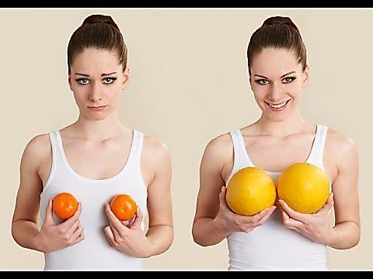
WHAT I WANT IS VERY EASY TO UNDERSTAND…. Isn’t IT ?
BREAST AUGMENTATION

Slide 28
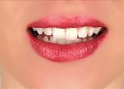
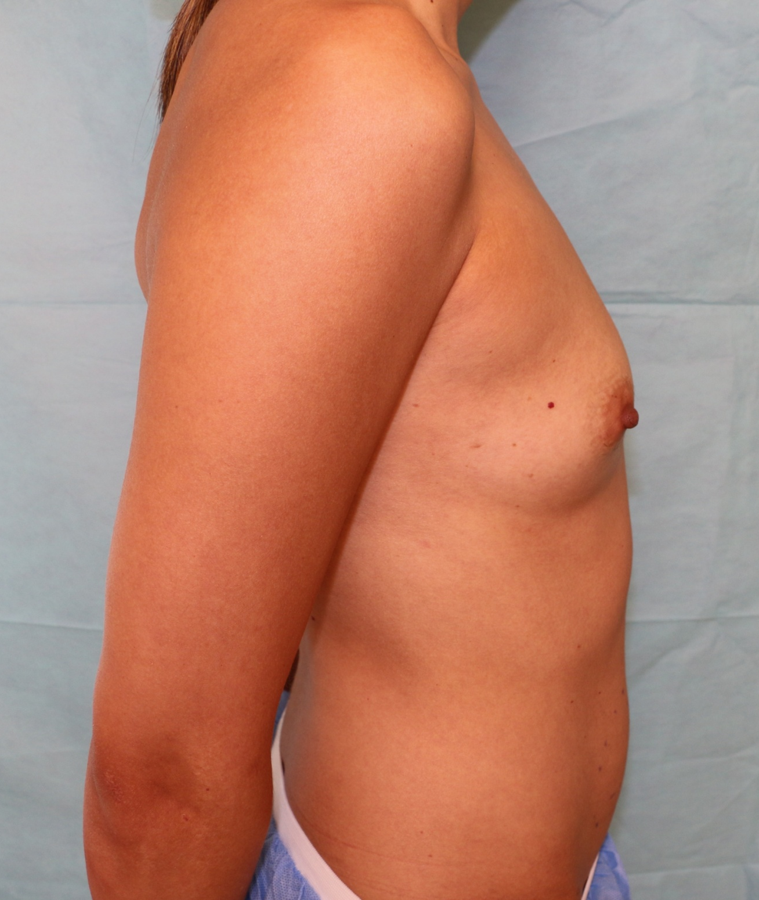
I WANT THE SAME
BREAST AUGMENTATION
( Submuscular Technique )

Slide 29
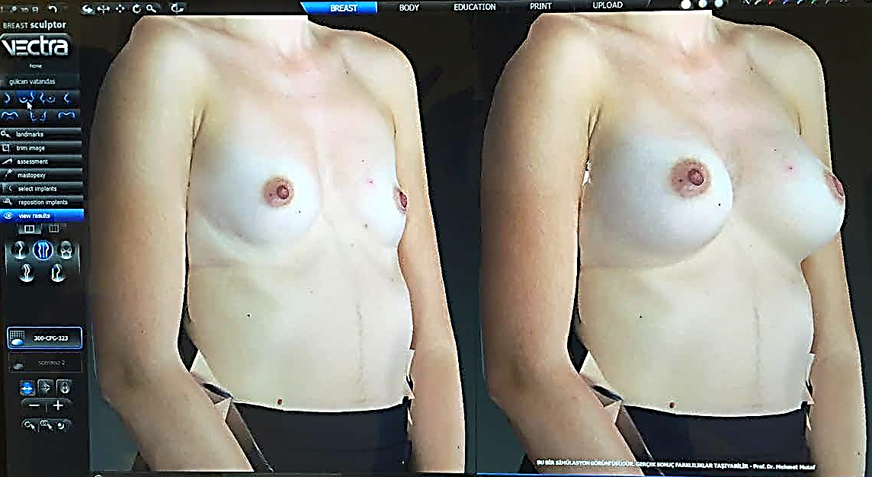
PREOPERATIVE SIMULATION

Slide 30
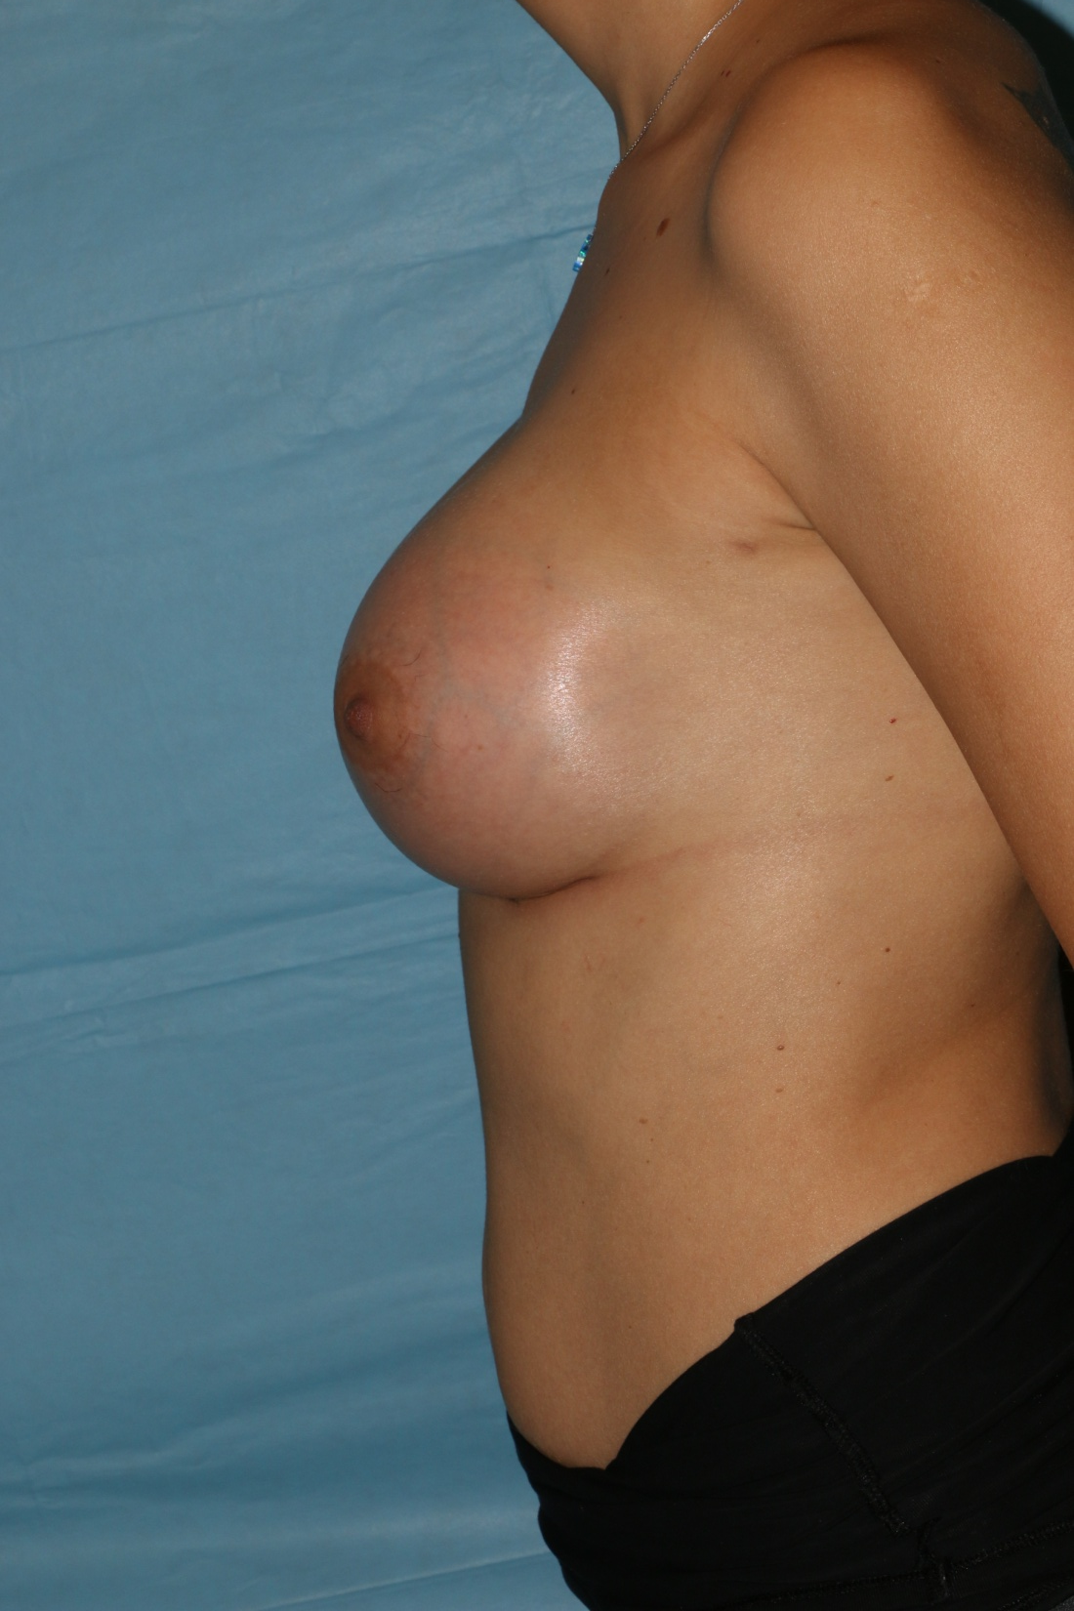
BREAST AUGMENTATION
( Submuscular Technique –430 cc Anatomical Implant )

Slide 31
BREAST AUGMENTATION
( Submuscular Technique – Anatomıcal Implant )

Slide 32
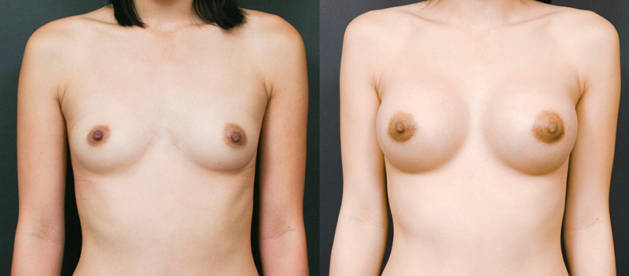
BREAST AUGMENTATION
( Subglandular Technique- Round Implant )

Slide 33
BREAST AUGMENTATION
( Subglandular Technique –425 cc Round Implant )

Slide 34
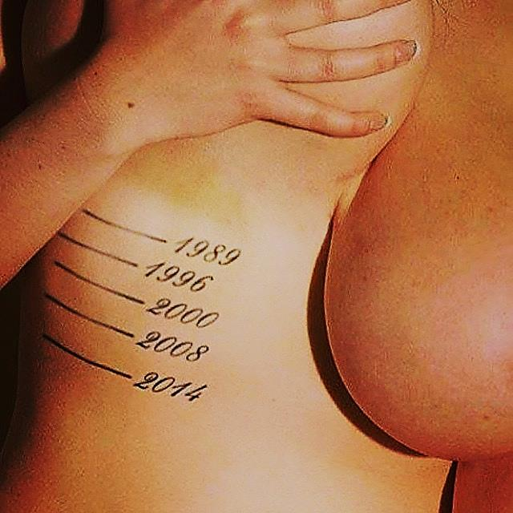
TIME and GRAVITY AGAINST MELONS

Slide 35
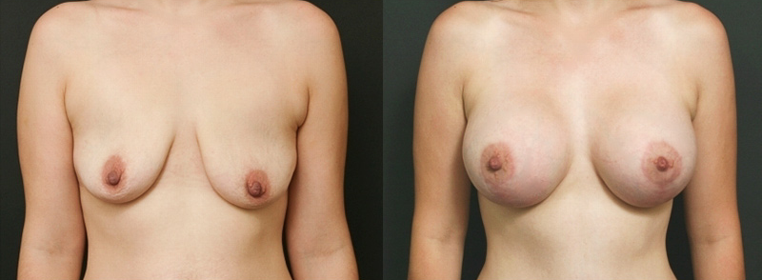
VERTICAL SCAR BREAST LIFT +BREAST AUGMENTATION
( Subglandular Technique – 410 cc Round Implant ) )

Slide 36
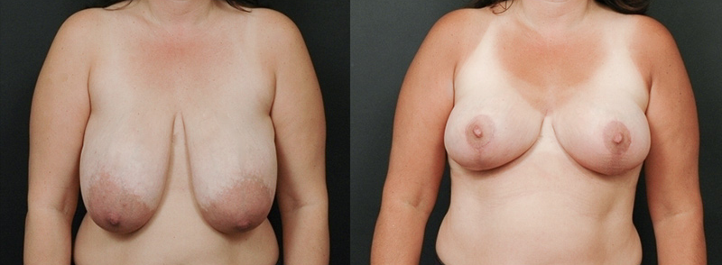
I WANT SMALLER
REDUCTION MAMMOPLASTY
REDUCTION MAMMOPLASTY

Slide 37
REDUCTION MAMMOPLASTY
( Preservation of Breast Feeding Potential with Central Pedicle Technique )

Slide 38
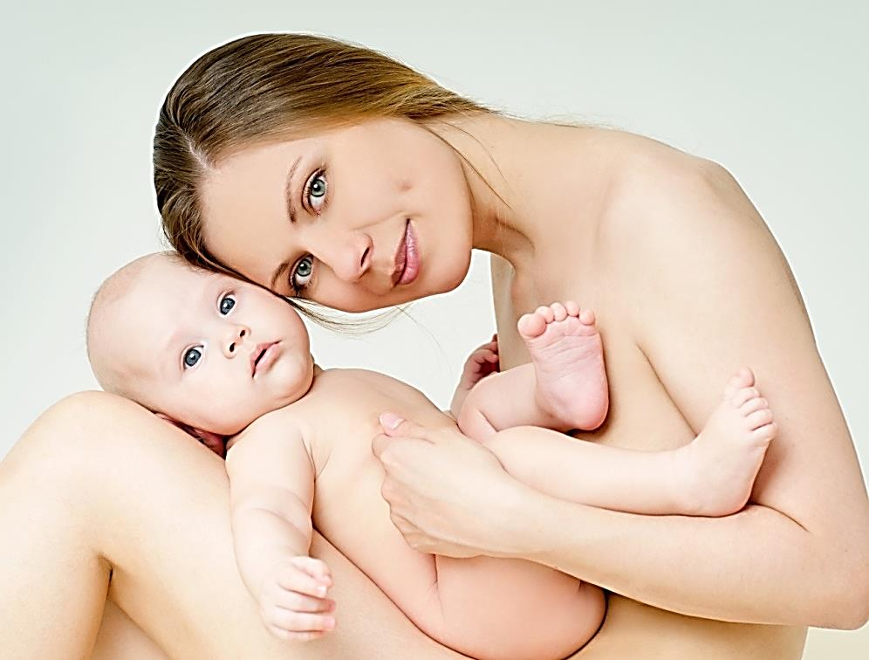
EVERYTHING HAS A COST …

Slide 39
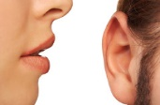
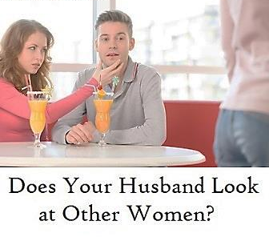
I WANT MY HUSBAND STOP LOOKING AT OTHER FEMALES !
Universty of Gaziantep, Plastic Reconstructive and Aesthetic Surgery Department
TURKEY 2007

Slide 40
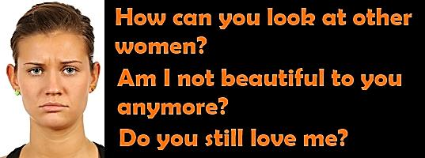
Universty of Gaziantep, Plastic Reconstructive and Aesthetic Surgery Department
TURKEY 2007

Slide 41
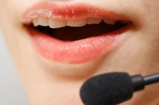
HOW CAN I GET MY BODY BACK ?
I WANT MY BODY BACK … AND MY HUSBAND TOO
Universty of Gaziantep, Plastic Reconstructive and Aesthetic Surgery Department
TURKEY 2007

Slide 42
Mommy Makeover:
Plastic Surgery After Childbirth Post-pregnancy makeover or mommy makeover is one of the best ways to regain a woman's pre-pregnancy figure. It is a cosmetic surgery that involves many small surgeries or procedures like breast lift, breast reduction, tummy tuck, etc. Let us find out more about this post-pregnancy cosmetic surgery.
Universty of Gaziantep, Plastic Reconstructive and Aesthetic Surgery Department
TURKEY 2007

Slide 43
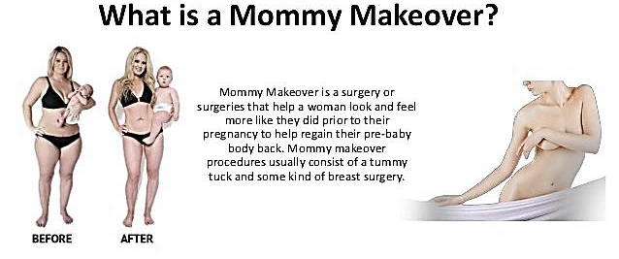
Universty of Gaziantep, Plastic Reconstructive and Aesthetic Surgery Department
TURKEY 2007

Slide 44
AFTER 3 CHILDREN, HOW CAN I GET MY BODY BACK ?

Slide 45
YESSS… IT IS POSSIBLE !

Slide 46
MOMMY MAKEOVER AUGMENTATION MAMMOPLASTY + MINI ABDOMINOPLASTY
asty )

Slide 47
MOMMY MAKEOVER
MOMMY MAKEOVER PROCEDURES
( Mastopexy + Breast Implant + Tummy Tuck )

Slide 48
MOMMY MAKEOVER AUGMENTATION MAMOPLASTY + MINI ABDOMINOPLASTY

Slide 49
MOMMY MAKEOVER MASTOPEXY + AUGMENTATION MAMOPLASTY + ABDOMINOPLASTY

Slide 50
MOMMY MAKEOVER MASTOPEXY + AUGMENTATION MAMOPLASTY + ABDOMINOPLASTY

Slide 51
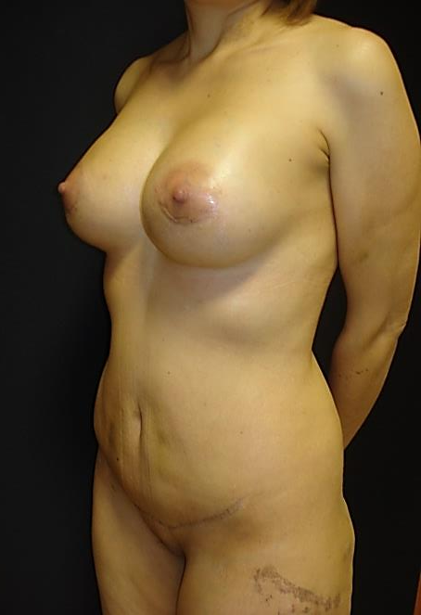
MOMMY MAKEOVER AUGMENTATION MAMOPLASTY + ABDOMINOPLASTY + LİPOSUCTION

Slide 52
GRANDMA MAKEOVER
WHAT … IF I AM A GRANDMOTHER, CANT I WANT MY BODY BACK ?

Slide 53
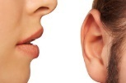
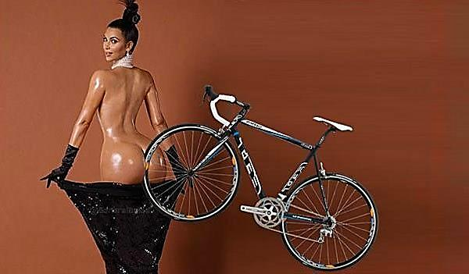
Doctorrrr, I WANT A BUTT LIKE HERS !

Slide 54
New Trend in Aesthetic Society BUTT AUGMENTATION

Slide 55
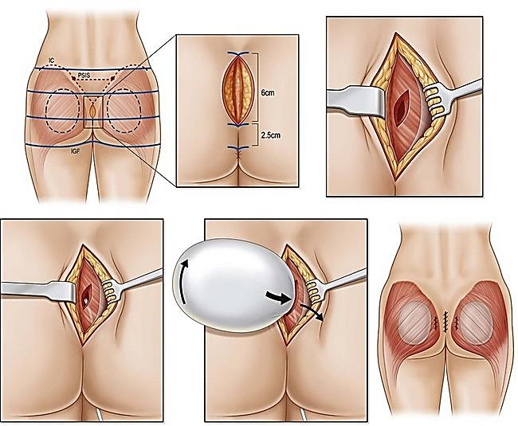

Slide 56
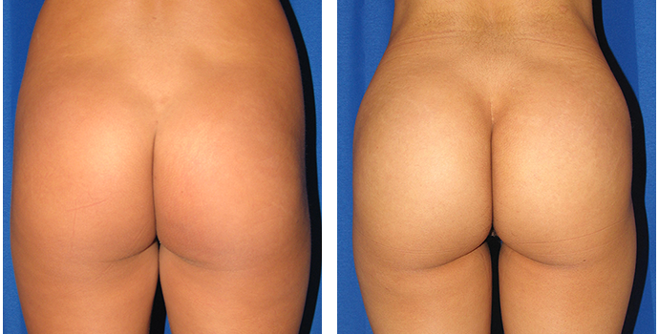
BUTTOCK AUGMENTATION with GLUTEAL IMPLANT

Slide 57
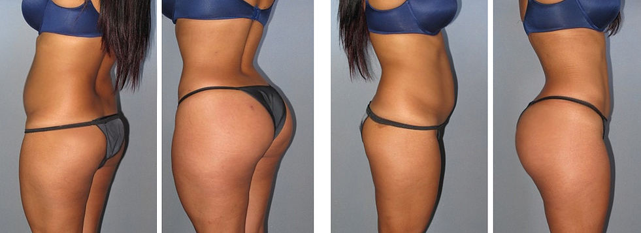
BUTTOCK AUGMENTATION with GLUTEAL IMPLANT
Infrasonic (tickle lipo) Liposuction

Slide 58
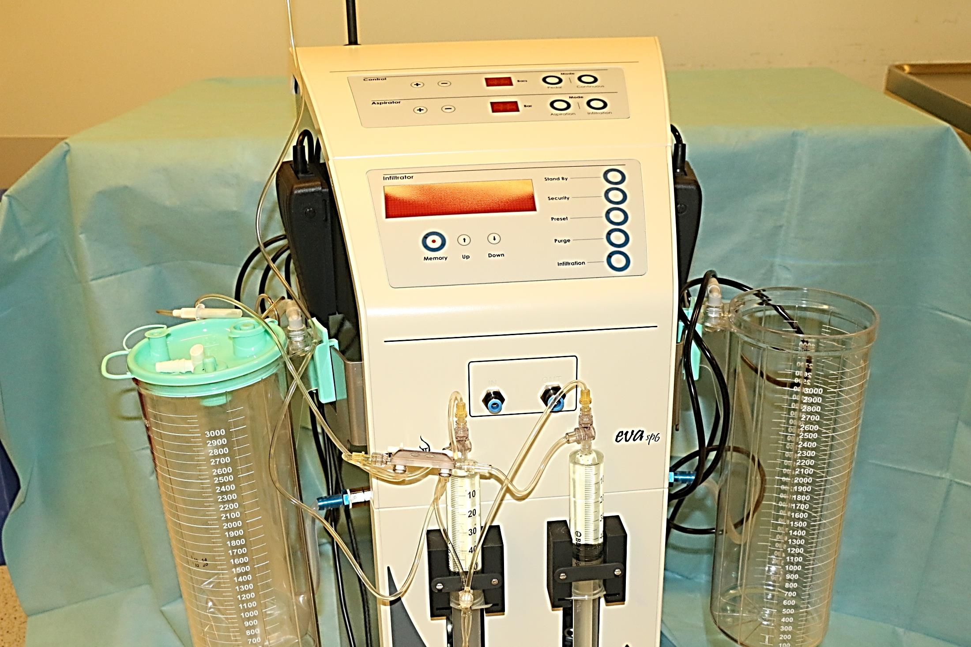
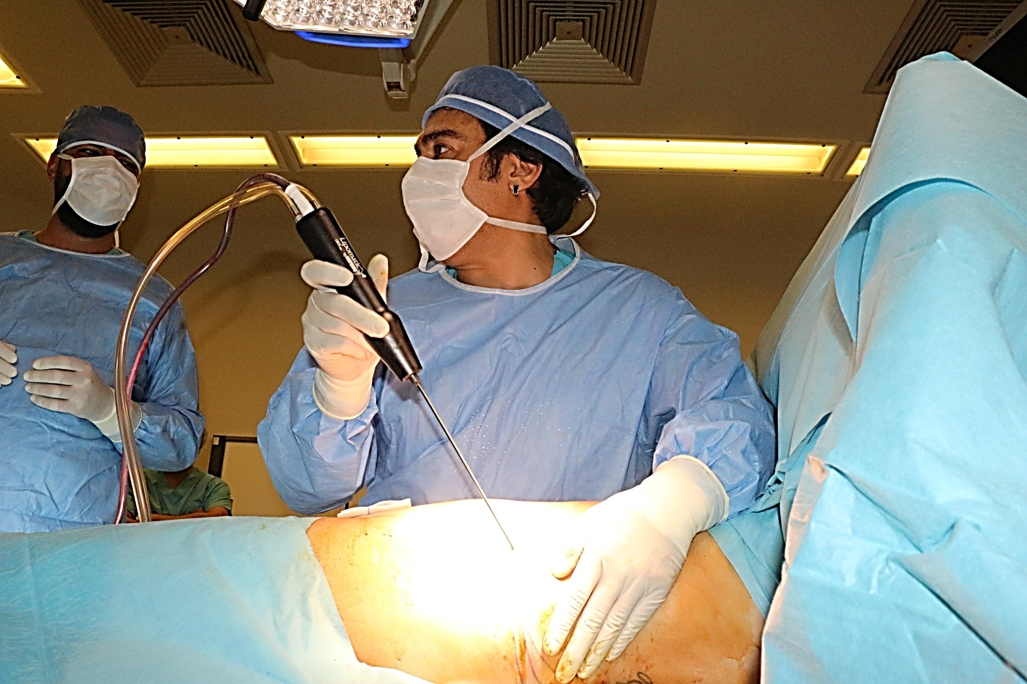
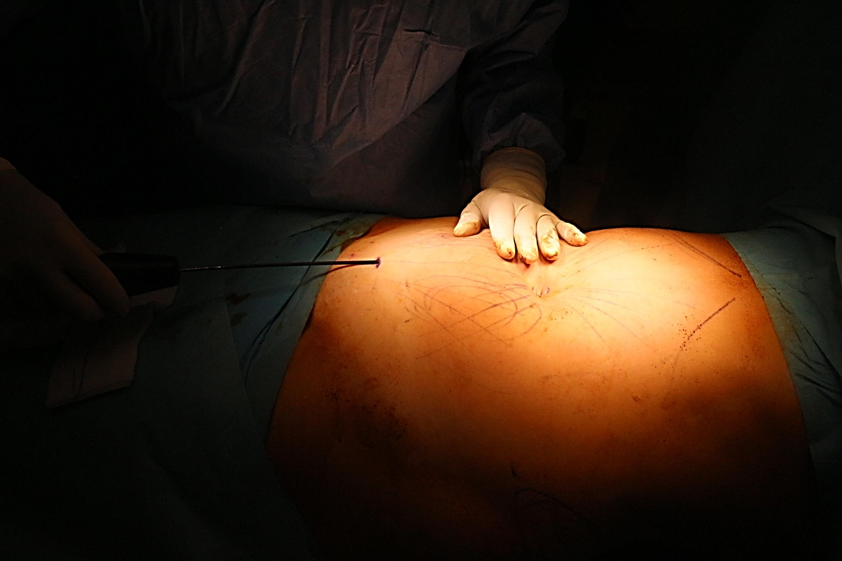
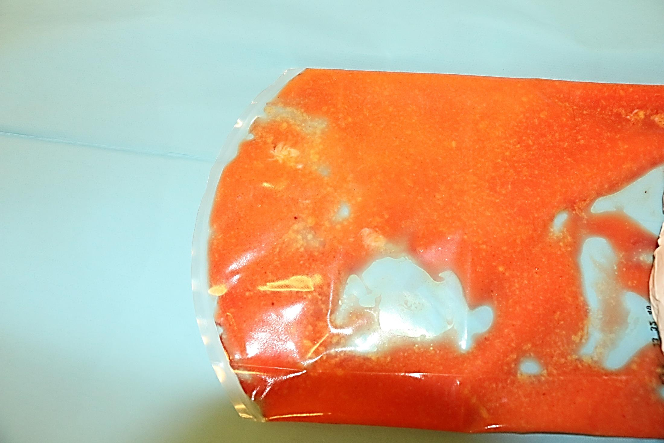

Slide 59
Lipofilling
THE BEST FILLER IS YOUR OWN TISSUE !

Slide 61
BUTT AUGMENTATION with FAT INFILTRATION

Slide 62
BUTT AUGMENTATION with FAT INFILTRATION

Slide 63
BUTT AUGMENTATION with FAT INFILTRATION Infrasonic (tickle lipo) Liposuction

Slide 64
Uhm…doctor, i dont know how to say but …

Slide 65
GENITAL AESTHETIC

Slide 66
VAGINAL THIGHTENING

Slide 67
GENITAL REJUVENATION

Slide 68
PLEASE GIVE ME LIPS TO SMILE

Slide 69
Smile Surgery
CLEFT LIP AND PALATE
( incidence 1/1000 )

Slide 70
CLEFT LIP NOSE DEFORMITY

Slide 71
Elevation of Nasal Floor with a Piece of Bone Harvested from the Chin
CLEFT LIP NOSE DEFORMITY

Slide 72
CLEFT LIP NOSE DEFORMITY

Slide 73
CLEFT LIP NOSE DEFORMITY
Before
After
DOĞUMSAL ANOMALİLERLE MÜCADELE DERNEĞİ

Slide 74
PROMINENT EAR DEFORMITY
DOCTOR I WANT YOU STOP MY FRIEND TEASING ME
BECAUSE OF MY EARS…PLEEEASE ☹
The Most Common Anomaly of the FACE
Universty of Gaziantep, Plastic Reconstructive and Aesthetic Surgery Department
TURKEY 2007

Slide 75
DAT – DERMAL ANCHOR TECHNIQUE - M. Mutaf
DERMAL ANCOR TECHNIQUE (=DAT)

Slide 76
Dermal Ancor Technique (=DAT)

Slide 77
Dermal Ancor Technique (=DAT)
EASY
NO EDEMA
QUİCK
NO PAIN
PERMANENT
NO RISK

Slide 78
Dermal Ancor Technique (=DAT)

Slide 79
I WANT JUST AN EAR …PLEASE !

Slide 80
MICROTIA
Incidence 1/6000

Slide 81
MICROTIA TYPES

Slide 82
ARTIFICIAL SOLUTIONS….BIG PROBLEMS
İNSİDANS
Prof. Dr. Mehmet Mutaf

Slide 83
MAKING A NEW EAR IS NOT AN EASY TASK
SIMILAR UNSUCCESFUL RESULTS from VARIOUS COUNTRIES

Slide 84
WHAT I WANT WAS AN EAR SIR … NOT SOMETHING LIKE THAT !

Slide 86
ÖNCE
SONRA – 1.AY
AUTOGENOUS TISSUE
The Most Valuable Material
HARVESTING OF THE 6-8 TH RIB CARTILAGES FROM THE CHEST

Slide 87
SCUPTURING A NEW EAR from THE RIB CARTILAGE S of THE PATIENT

Slide 92
SHE IS 6 YRS OLD

Slide 93
SHE WANTS NORMAL EARS AS HER FRIENDS

Slide 94
Prof. Dr. Mehmet Mutaf

Slide 95
REPLICATION OF THE NORMAL EAR ANATOMY

Slide 96
PLACEMENT OF CARTILAGE FRAMEWORK UNDER THE SKIN

Slide 97
GIRL POWER
ONLY 30 MINUTES AFTER A 6 HOURS OF SURGERY

Slide 98
GIRL POWER
FIVE DAYS LATER VISITING US
A BEAUTIFUL DAY – 6 DAYS AFTER

Slide 99
AUTOGENOUS EAR RECONSTRUCTION

Slide 100
6
7
Prof. Dr. Mehmet Mutaf

Slide 103
EAR RECONSTRUCTION with OWN TISSUES of THE PATIENT

Slide 104
NO MORE TEARS FOR SMALL EARS

Slide 105
NO MORE TEARS FOR SMALL EARS
The First School Day

Slide 109
STELLA

Slide 110
BODRUM HASTANESİ

Slide 111
DOCTOR, CAN YOU SAVE ME FROM RECURRENCE OF MY SKIN CANCER PLEASE ?
TRIANGULAR CLOSURE TECHNIQUE – MUTAF

Slide 112
THE MOST COMMON CANCER IN WOMEN POPULATION 1/9

Slide 113
DOCTOR, I FEEL MYSELF HALF ☹
Breast Reconstruction
( Following Removal of Breast for Cancer Treatment )

Slide 114
DIEP – Deep Inferior Epigastric Flap

Slide 115
DIEP – Deep Inferior Epigastric Flap
Breast Reconstruction
( Following Removal of Breast for Cancer Treatment )

Slide 116
BREAST RECONSTRUCTION
BILATERAL DIEP – Deep Inferior Epigastric Flap

Slide 117
BREAST RECONSTRUCTION
LATISSIMUS DORSI FLAP + IMPLANT

Slide 118
AESTHETIC PLASTIC SURGERY

Slide 119
AESTHETIC PLASTIC SURGERY

Slide 120
AESTHETIC PLASTIC SURGERY

Slide 121
Violence Against Women
Facial Fractures

Slide 122
Violence Against Women
LASERATIONS AND CUTS
Cuts and Lacerations

Slide 123
VIOLENCE AGAINST WOMAN

Slide 124
AESTHETIC PLASTIC SURGERY

Slide 125
HOW I CAN GET MY FACE BACK ?

Slide 126
VIOLENCE AGAINST WOMEN ACID BURN
12 YEARS
VIOLENT

Slide 127
VIOLENCE AGAINST WOMEN ACID BURN

Slide 128
VIOLENCE AGAINST WOMEN FACIAL ACID BURN

Slide 129
VIOLENCE AGAINST WOMEN FACIAL ACID BURN

Slide 130
VIOLENCE AGAINST WOMEN FACIAL ACID BURN
Lower Lid Reconstruction

Slide 131
VIOLENCE AGAINST WOMEN ACID BURN
After 11 previous operations to save her life
Gaziantep Üniversitesi Tıp Fakültesi, Plastik, Rekonstrüktif ve Estetik Cerrahi Anabilim Dalı - 2008

Slide 132
VIOLENCE AGAINST WOMEN ACID BURN
Gaziantep Üniversitesi Tıp Fakültesi, Plastik, Rekonstrüktif ve Estetik Cerrahi Anabilim Dalı - 2008

Slide 133
VIOLENCE AGAINST WOMEN NECK CONTRACTURE - ACID BURN
Gaziantep Üniversitesi Tıp Fakültesi, Plastik, Rekonstrüktif ve Estetik Cerrahi Anabilim Dalı - 2008

Slide 134
VIOLENCE AGAINST WOMEN ACID BURN
Gaziantep Üniversitesi Tıp Fakültesi, Plastik, Rekonstrüktif ve Estetik Cerrahi Anabilim Dalı - 2008

Slide 135
VIOLENCE AGAINST WOMEN ACID BURN
Gaziantep Üniversitesi Tıp Fakültesi, Plastik, Rekonstrüktif ve Estetik Cerrahi Anabilim Dalı - 2008

Slide 136
VIOLENCE AGAINST WOMEN ACID BURN
WORLD’S FIRST EAR RECONSTRUCTION by USING ABDOMINAL SKIN
Gaziantep Üniversitesi Tıp Fakültesi, Plastik, Rekonstrüktif ve Estetik Cerrahi Anabilim Dalı - 2008

Slide 137
VIOLENCE AGAINST WOMEN ACID BURN
WORLD’S FIRST EAR RECONSTRUCTION by USING ABDOMINAL SKIN
Gaziantep Üniversitesi Tıp Fakültesi, Plastik, Rekonstrüktif ve Estetik Cerrahi Anabilim Dalı - 2008

Slide 138
VIOLENCE AGAINST WOMEN ACID BURN
WORLD’S FIRST EAR RECONSTRUCTION by USING ABDOMINAL SKIN
Gaziantep Üniversitesi Tıp Fakültesi, Plastik, Rekonstrüktif ve Estetik Cerrahi Anabilim Dalı - 2008

Slide 139
VIOLENCE AGAINST WOMAN - ACID BURN
WORLD’S FIRST EAR RECONSTRUCTION by USING ABDOMINAL SKIN

Slide 140
VIOLENCE AGAINST WOMEN ACID BURN

Slide 141
VIOLENCE AGAINST WOMEN ACID BURN

Slide 142
VIOLENCE AGAINST WOMEN ACID BURN
Happy, married, mother of a lovely daughter.
THE BEST REVENGE IS YOUR SUCCES AND HAPPINESS !

Slide 143
ASİYE ENGİZ – 41 Y , Burn Injury at 1 yrs old. She had 17 operations before she Admit to Our Clinic SHE IS NOT SMILING…
I WANT A MIRACLE

Slide 144
SURGICAL PLAN

Slide 146
REMOVAL OF ENTIRE SCARRED SKIN OF THE FACE
+
CONSTRUCTION OF NASAL SCELETON

Slide 147
REMOVAL OF ENTIRE SCARRED SKIN OF THE FACE
+
CONSTRUCTION OF NASAL SCELETON

Slide 148
WAITING FOR A MIRACLE….

Slide 149
NOT A MIRACLE AT ALL ☹

Slide 150
MIRACLES NEED TIME

Slide 151
MIRACLES NEED TIME ☺

Slide 152
EYE BROW RECONSTRUCTION

Slide 153
AUTOGENOUS FACE RECONSTRUCTION – MUTAF TECHNIQUE
AMELİYAT TEKNİĞİ GÖRSEL ÖZETİ
Kaburgadan
kemik-kıkırdak dokusu
Saç Greftleri
3
KATMANLI YAKLAŞIM
İskelet çatı için
Kaşları oluşturmak için
Derialtı-yağ grefti
Önkol fasyası
Yüze 3 boyutlu form ve dolgunluk vermek için
Yüze 3 boyutlu form ve dolgunluk vermek için
Deri örtüsü alt yapısı oluşturmak için
Genişletilmiş
boyun derisi
Deri örtüsü olarak

Slide 155
AUTOGENOUS FACE RECONSTRUCTION – MUTAF TECHNIQUE

Slide 157
Muhittin Işık 34 y, Burn Injury 17 years ago – 52 operations in Germany,and France

Slide 158
Autogenous Total Face Reconstructıon – Mutaf Technique
Autogenous Total Face Reconstructıon – Mutaf Technique
PREOPERATIVE VIEWS

Slide 159
TOTAL FACE RECONSTRUCTION with OWN TISSUES OF HUMAN
MUTAF TECHNIQUE

Slide 160
TOTAL FACE RECONSTRUCTION with OWN TISSUES OF HUMAN
MUTAF TECHNIQUE

Slide 161
TOTAL FACE RECONSTRUCTION with OWN TISSUES OF HUMAN
MUTAF TECHNIQUE

Slide 162
14 April
TWO LITTLE PRINCESS CAME TO CELEBRATE THEIR DOCTOR’S BIRTHDAY HAND IN HAND

Slide 164
BODRUM HASTANESİ
DÜNYA’DA MÜMKÜNSE BODRUM’DA DA MÜMKÜNDÜR
Bodrum-TURKEY

Slide 166
WAITING YOU IN BODRUM
just a flight away

